Slide 1


Gas Not Found
Authors: Gaurav, Houston, Insiya, and Maya

Slide 2


Problem Statement
We want to predict how the vehicle population changes for the year 2024 to understand future fuel demand.
These predictions can help in planning for fuel supply, infrastructure development, and environmental policies.

Slide 3

Data Wrangling
41,054 rows of data
10 features such as: model year, fuel technology, and vehicle type
Replace missing values in model year with a forward fill first followed by a backwards fill
Handle "Not Applicable" and "Unknown" Values in GVWR Class by converting "Not Applicable" values to 0, representing light-duty passenger cars and replace "Unknown" with Relevant Substitutes

Slide 4
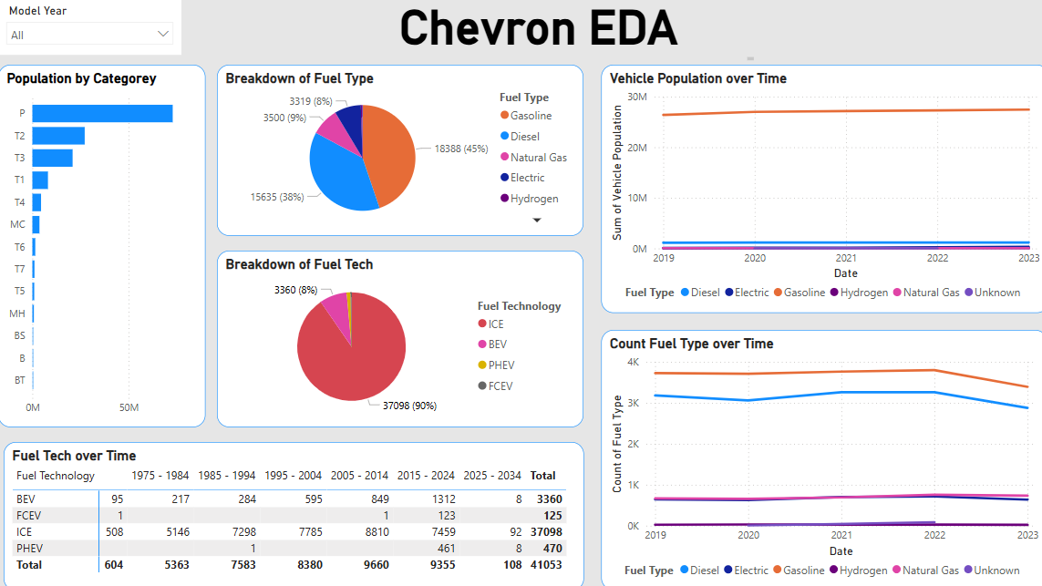
EDA

Slide 5


Feature Engineering
Max min scalar
Standard scalar
One hard encoded
Turned GVWR Class into an ordered classifier (light weight, medium weight, heavy weight)

Slide 6
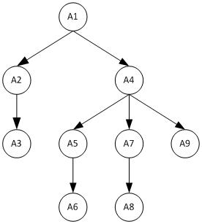
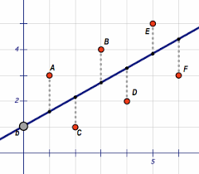
Regression Models
Linear Regression
Random Forest
Poisson Regression
Support Vector Regression
Decision Tree

Slide 7


Results
Best Performing Models (by RMSE):
CatBoost: 10665.3387
Random Forest: 10756.8602
XGBoost: 10791.4073
Gradient Boosting: 10856.2416
Poisson: 12618.6466

Slide 8
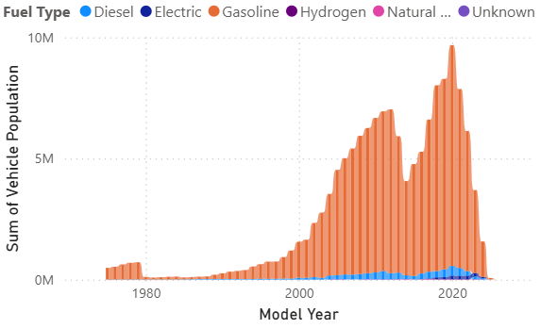
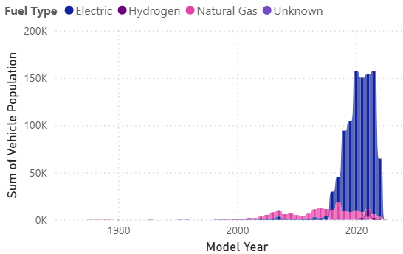
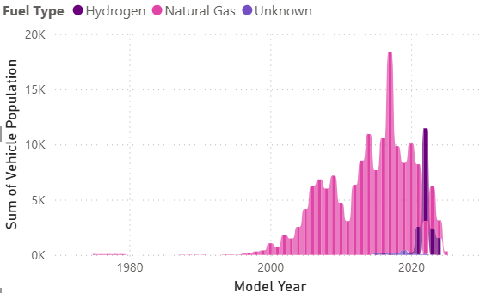
Future Outlook
Overall, the entire market will shrink in 2025 and sales will fall
Electric cars will start appearing more, but the market will see a majority of gas cars
Every 10 years there is a peak / valley pattern in model year

Slide 9

Cars of the Future
Gasoline: 25,500,000-26,000,000
Electrical: 250,000-300,000
Diesel: 105,000 - 110,000
Natural Gas: 25,000-33,500
Hydrogen: 2,500-5,000

Slide 10

Business and Societal Impact
Energy: In future years, gasoline powered vehicles will continue to dominate the market so there will be consistent demand for gasoline. EVs will also be on the rise, increasing the demand for electricity. Predictions will help optimize operations.
Cleaner Environment: Predicting vehicle populations helps plan for reduced emissions and better air quality, promoting the adoption of EVs.
Sustainable Practices: Addressing tire usage and promoting recycling reduces environmental impact, while advances in tire technology support sustainability.

Slide 11
Citations
“California Transportation Data for Alternative Fuels and Vehicles.” Alternative Fuels Data Center: California Transportation Data for Alternative Fuels and Vehicles, afdc.energy.gov/states/ca. Accessed 1 Feb. 2025.
“Vehicle Miles Traveled by Fuel Type.” California Energy Commission, California Energy Commission, www.energy.ca.gov/data-reports/surveys/california-vehicle-survey/vehicle-miles-traveled-fuel-type. Accessed 1 Feb. 2025.

